Slide 1
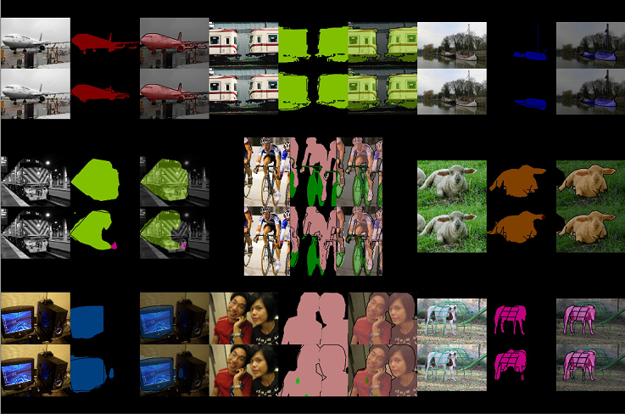
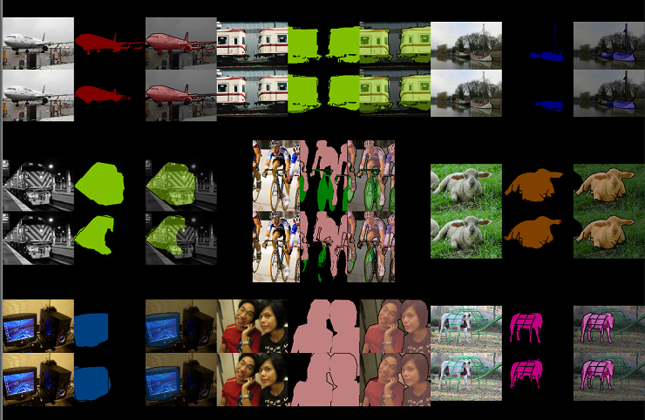

Slide 4


arXiv:1711.04483v2 [cs.CV] 27 Dec 2017
3D CNN
deconvolution

Slide 5
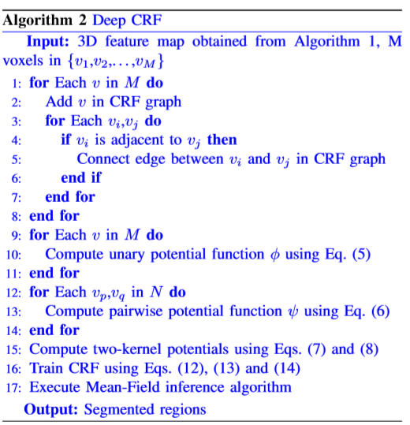







Slide 6

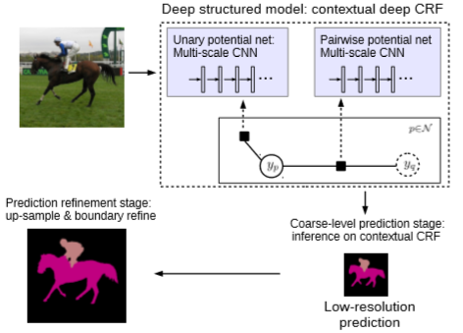
arXiv:1504.01013v4 [cs.CV] 6 Jun 2016

Slide 7
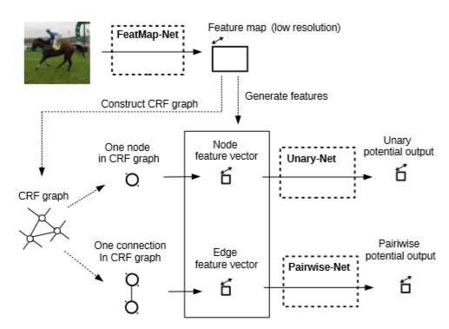

Slide 8
